Slide 1
Ace
Ace
Ace
Ace
Ace
1
11
1
11
1
Bet 3 Cards; Total Sum:
22+ Bust
18-21 Win
<18 Bust
17 Tie
FULL MONTE

Slide 2
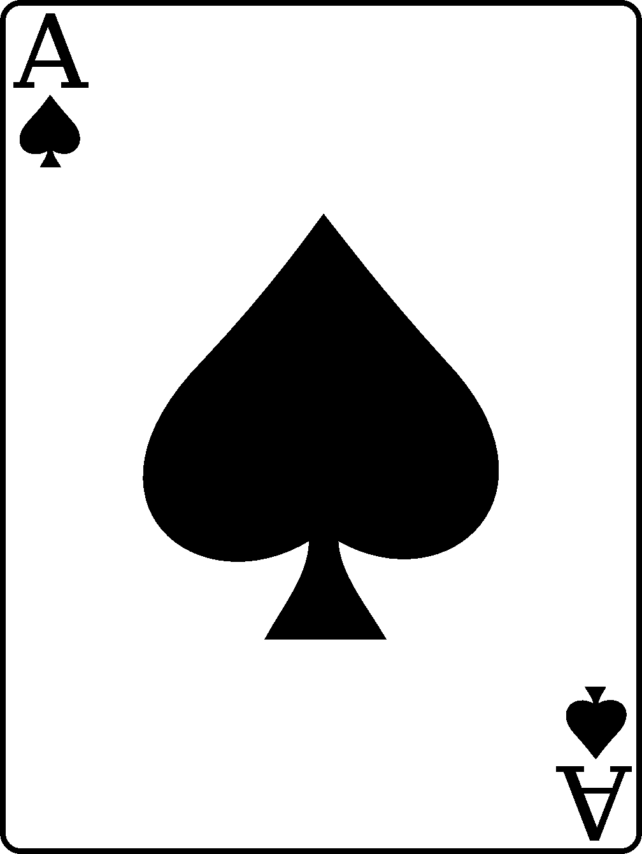
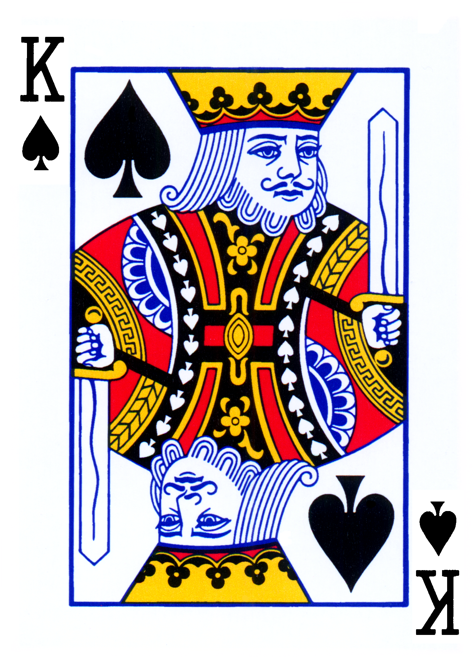
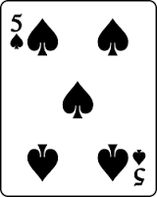
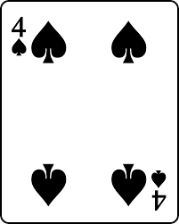
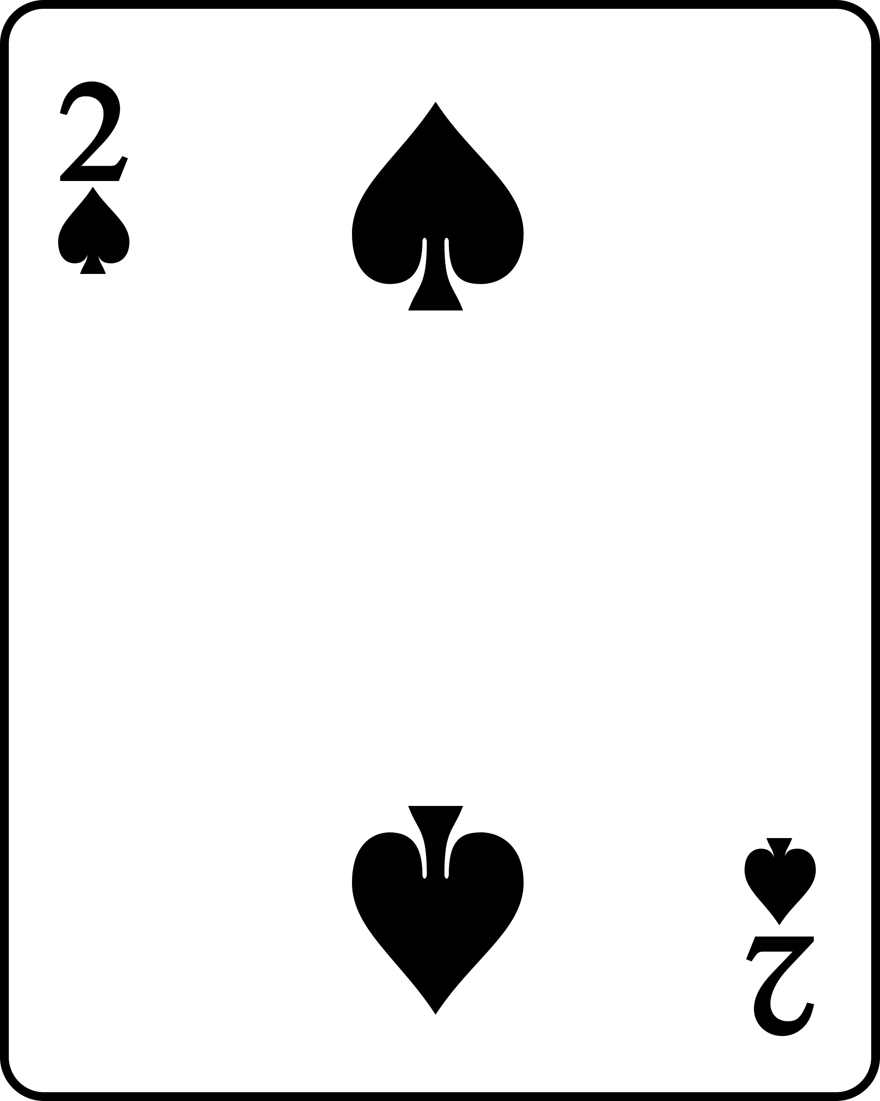
1
11
1
11
1
Bet 3 Cards; Total Sum:
22+ Bust
18-21 Win
<18 Bust
FULL MONTE

Slide 3

1
11
1
11
1

Slide 4
1
11
1
11
1

